Slide 1
SH Trading AS

Slide 2
SH Trading AS is a key supplier of electrical goods and a partner for our customers. Our customers in the marine market is typically Shipping, Oil & Gas and Cruise.
SH TRADING AS
SH Trading AS is a key supplier of electrical goods and a partner for our customers.
We operate within Shipping, Oil & Gas and Cruise.

Slide 3

SH Trading moves to new premises in Bergen West in 2004 . The company expanded in pace with the increase of the Norwegian ship fleet and is a major supplier to the Offshore deepsea cruise and cargo shipping companies
SH TRADING AS HISTORY
2002-2004
SH Trading is established in September 2002 and located in Bergen, westcoast of Norway.
MK Group was acquired and all employees came from Hatvik Trading AS, a company of MK group
SH Trading becomes official supplier to Incentra 's members.
2004-2013
SH Trading moves to new premises in Bergen West in 2004 .
The company expanded in pace with the increase of the Norwegian ship fleet and is a major supplier to the Offshore deep sea cruise and cargo shipping companies
.
2013-2016
Onninen AS acquires 100% stake in SH Trading as part of its oil , marine and gas investment
SH Trading composed as a separate legal entity in Onninen Group.
SH Trading moves to new premises with Onninen Express in Godvik, Bergen.
SH Trading sets new strategic direction with a focus on providing market value added for increased profitability in the industry.
2016-2020
SH Trading is preparing for the future to become a preferred partner and the customer's first choice within merchandise availability and easy information flow.
SH Trading conducts an organizational re-design that enables the implementation of our new strategy , as well as facilitate the future development of the shipping market

Slide 4


SH TRADING AS IS A COMPANY OWNED BY ONNINEN AS
Main focus on Norwegian and
foreign ship fleet ,
Offshore and onshore
industry.
More competitive and better access to products from the main warehouse.
Close cooperation provides better access to expertise.
Notes:
SH TRADING AS IS A SELF COMPANY IN ONNINEN GROUP.

Slide 5
SH TRADING AS ORGANIZATION
Managing Director
Atle Damm
Quality Manager (Onninen AS)
Giert Flock
Finance/ Back-office
Anne M. Sæle
Nanni Moe
Board
Teamleader Sale
Ove Lyngved
Sale
Gerd K. Sæle
Kjell Fjeldstad
Mone Myrvedt
Thomas Nilsen
Bernt Fjeldstad
Roy Skorpen
Warehouse/ Purchasing/ Logistic
Gunnar Johnsen
Thomas Tverberg

Slide 6
WIDE RANGE
Electrical
Pressure & temperature control
ATEX
Laundry machines & parts
Emergency power & charging
Lockout power & Process
Wide range customized ships and offshore .
With a wide range of goods on offer , the customer can get "everything" from one supplier
Warehouse Operator products that would otherwise have long delivery times

Slide 7

ONE SUPPLIER GIVES COST REDUCTIONS
CUSTOMER
SUPPLIER
SUPPLIER
SUPPLIER
SH TRADING AS
ONE SUPPLIER SAVES TIME AND MONEY
ONE SHIPPING SAVES TRANSPORT AND AGENT COST
ONE INVOICE SAVES INVOICE TREATMENT COST AND TIME

Slide 8
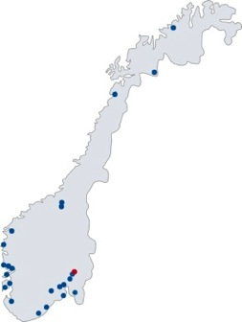
LOGISTICS
PRODUCT SUPPLY FROM OUR 26 EXPRESS STORES
WORLD WIDE DELIVERY
DELIVERY FROM BOTH BERGEN AND OSLO

Slide 9
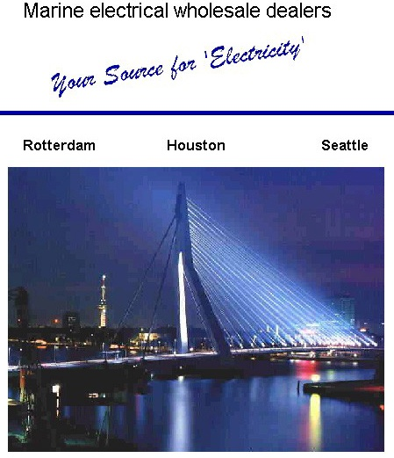
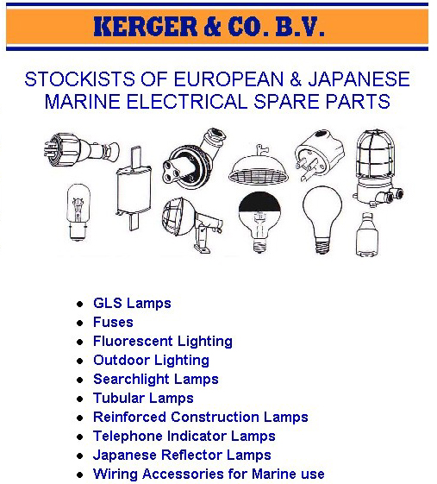
WAREHOUSE FOR PRODUCT DELIVERY IN ROTTERDAM

Slide 10










OUR PARTNERS

Slide 11












OUR PARTNERS

Slide 12













OUR PARTNERS

Slide 13
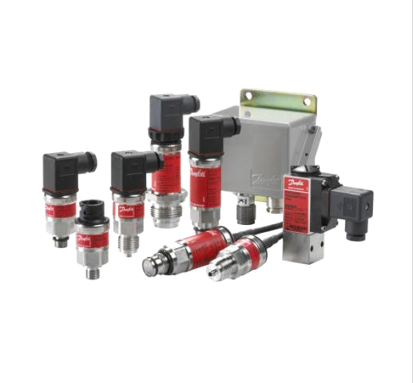
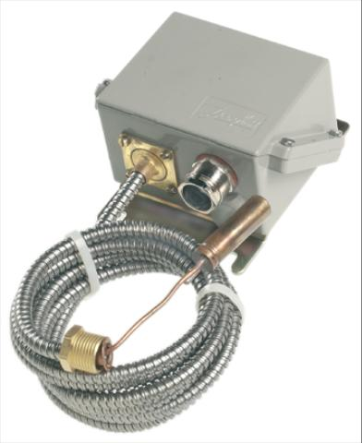
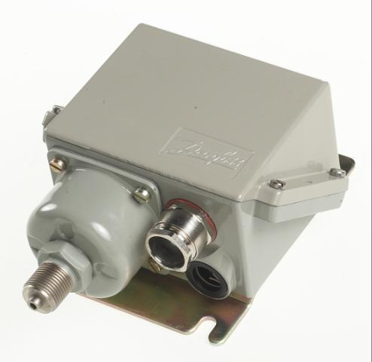
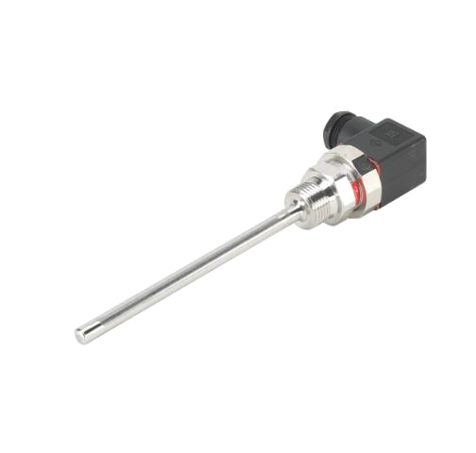
Danfoss

Slide 14



Solartron Mobrey

Slide 15
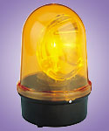
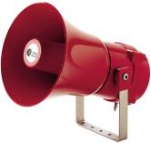
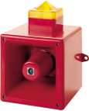



E2S, Werma & Pfannenberg

Slide 16

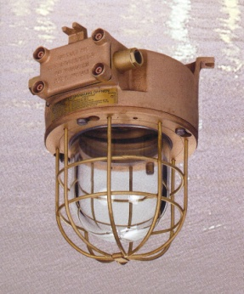
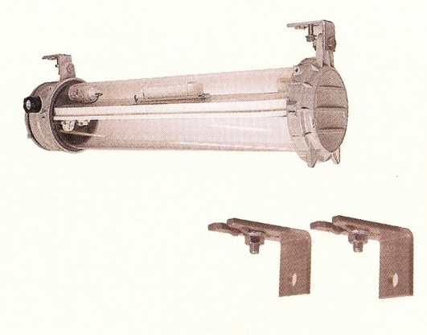
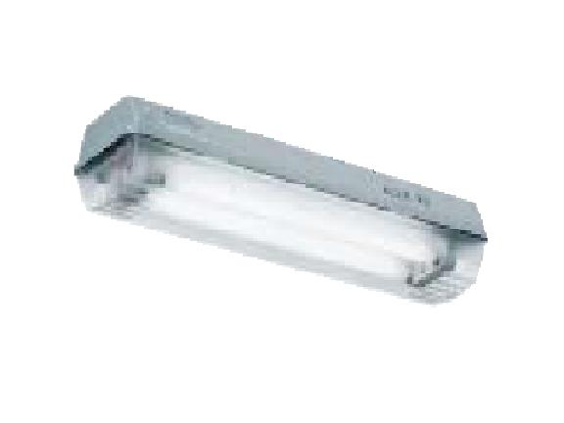
ASSORTED SHIPBOARD LIGHTING
Høvik Marine
Tranberg
Aqua Signal
Ceag

Slide 17






BATTERY
Komplett LOTO 6,
sett av 35 deler

Slide 18
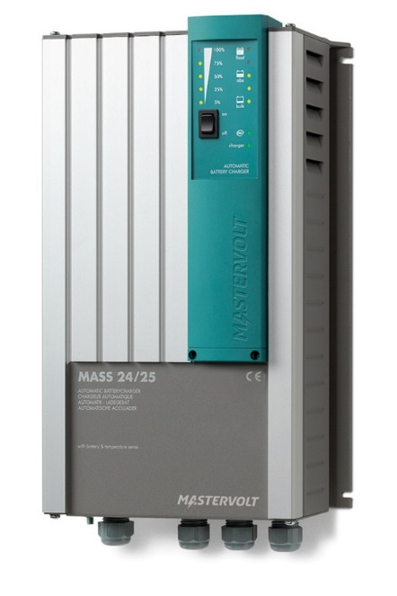
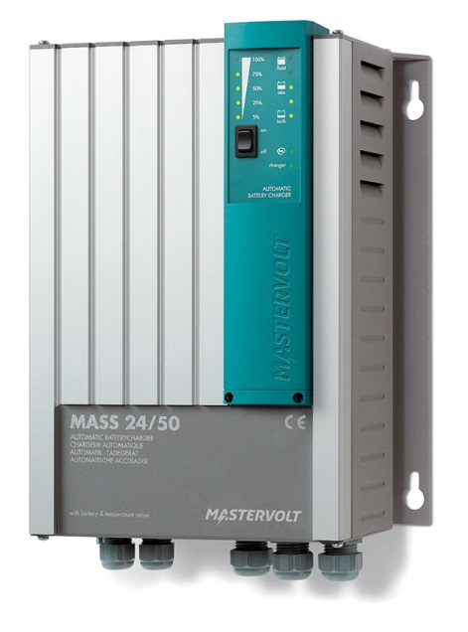

MASTERVOLT MARINE CHARGER
Komplett LOTO 6,
sett av 35 deler

Slide 19
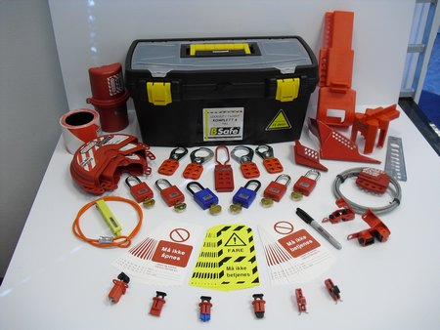
LOTO LOCKOUT
Complete LOTO 6, set of 35 parts

Slide 20




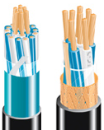

MARINE & OFFSHORE CABLES

Slide 21
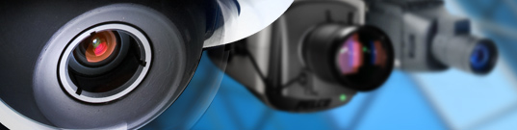

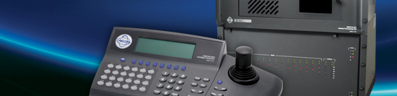

PELCO by Schneider Electric

Slide 22









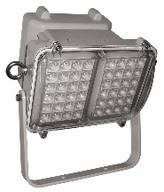
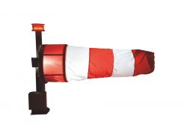

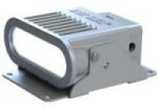
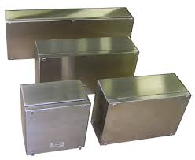
ADEPTOR PRODUCTS
Industrial telephones
PAGA field equipment
PAGA system
Intercom
Signal equipment
Industrial ethernet
Temporary lighting
Telecom
Belysning
Industriell IT
Time synchronization
EX Elektro
Floodlights
Helideck
Cable entries
Boxes
Pilot devices

Slide 23


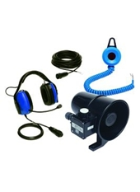
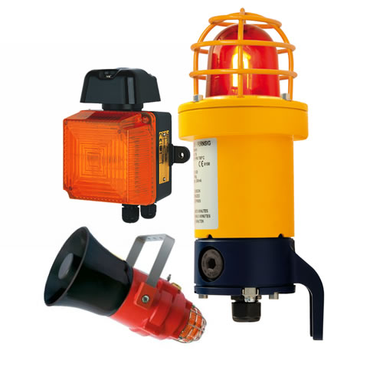
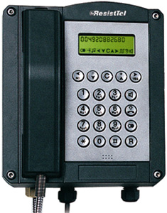
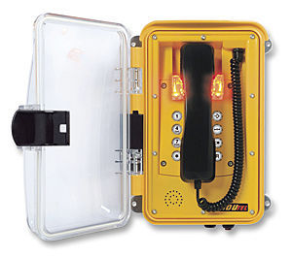
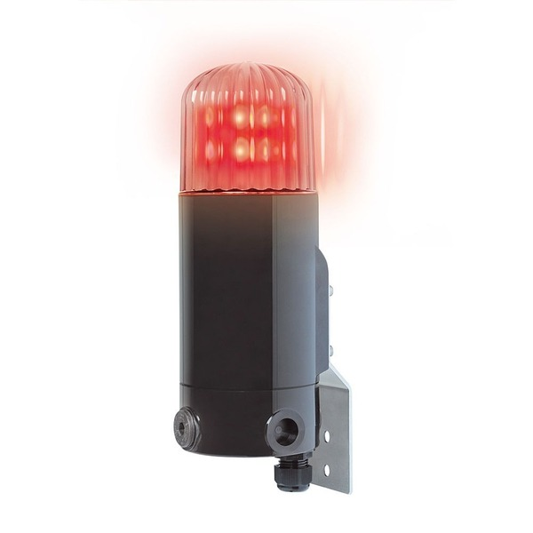
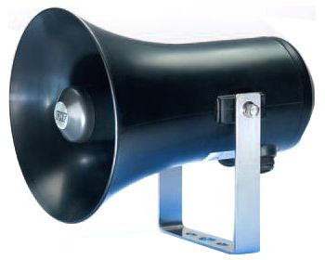
PHONE AND SIGNAL EQUIPMENT
Industrial telephones for extreme conditions
Signaling equipment for industry, oil and gas
FHF has made ​​industrial telephones and signaling equipment for over 100 years and is one of the most known and respected suppliers in its market segment . Several thousand Ex phones are delivered on Norwegian

Slide 24
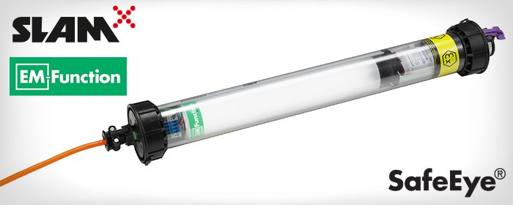
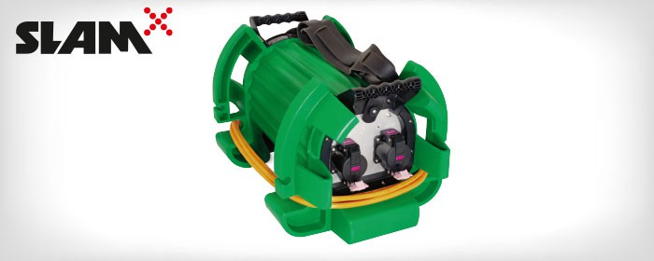
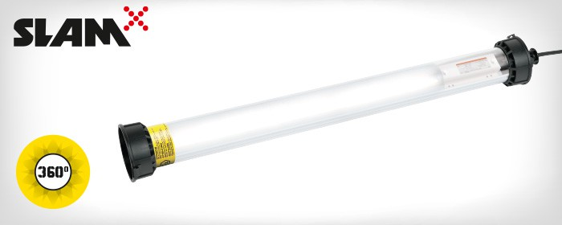
ATEXOR ATEX BELYSNING
SLAM® HORNET EM 1LED
Ex-certified for zones 1 and 2 and temperature class 4.
Strong lumens with SafeEye® protection.
Portable, move while connected.
Extremely robust construction.
Rechargeable back-up battery unit.

Slide 25
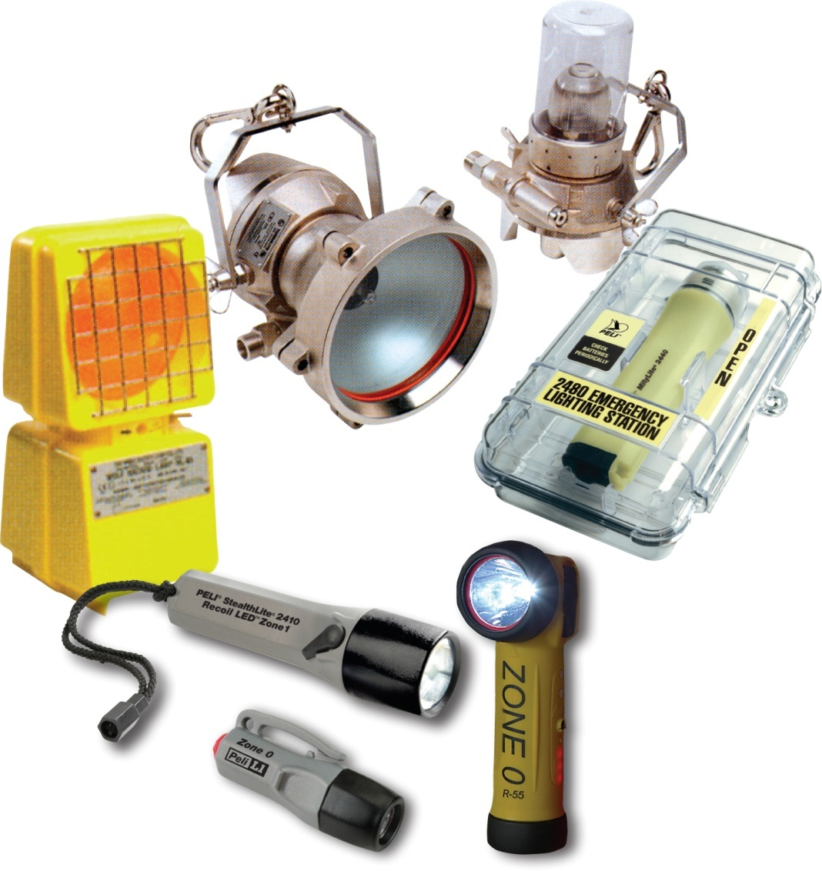

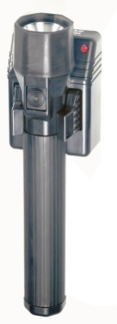
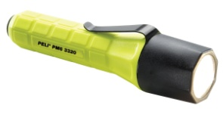
PELI, WOLF, MAGLITE & LEDLENSER
Flashlights
SH Trading delivers a complete assortment of quality flashlights for professional use, including Atex approved versions.
Mini LED-flashlights
Penlights
Rod style flashlights
Hand lamps
Headlamps
Rechargeable flashlights
Inspection lights
Rechargeable work lamps
Portable fluorescent lamps
ATEX Tank System fluorescent lamps
Air driven lamps of 250W
Blinkers

Slide 26
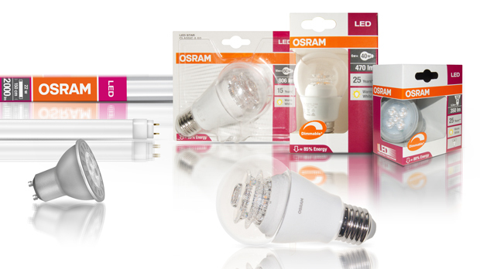
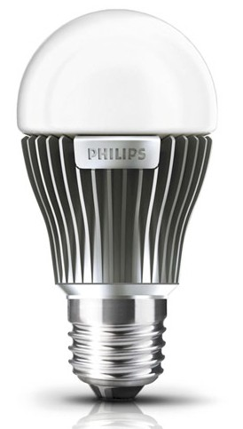
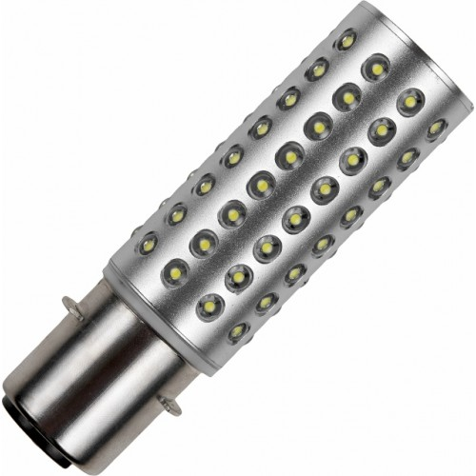
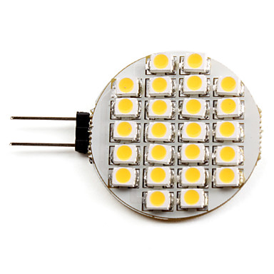
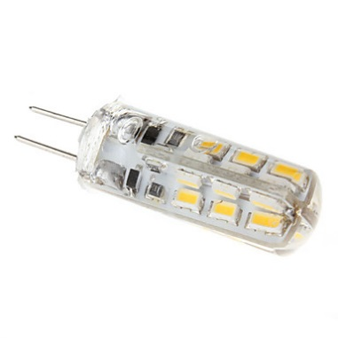
LED LAMPS
.

Slide 27
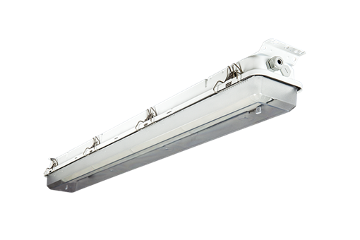
GLAMOX MIR LED
MIR LED is a high quality industrial / marine fittings with longevity. Developed for areas with temperatures from -30ºC To + 45ºC . MIR LED is available in two different types of material , stainless or aluminum / zinc treated steel . Supplied with self-extinguishing V0 plastic cover in impact resistant polycarbonate . Optional with KEM diffuser. The luminaire has a wide range of installation options , minimal maintenance and excellent overall economy.
LED luminaire supplied with impact-resistant polycarbonate (PC) or modified impact resistant acrylic ( KEM ) diffuser. Acrylic screen is particularly suitable for environments exposed to ammonia gas. MIR LED has a hinged gear tray with quick connector to facilitate maintenance . Most variants can be supplied with emergency lighting systems with internal battery ( Ta = 25 ) or external battery box

Slide 28
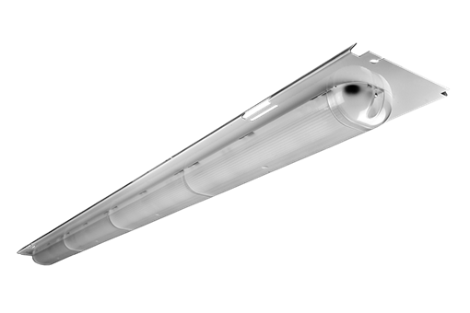
GLAMOX MIR KIT LED
MIR KIT LED is a replacement kit to upgrade MIR T5 / T8 to an energy-efficient LED solution with lifetime of at least 50,000 hours ( L70 ) . Equipped with quick release for easy replacement . Designed for areas with temperatures from -30ºC to + 45ºC . MIR KIT LED is also available with different types of integrated emergency both internal battery and battery box . MIR KIT LEDs can also be used to upgrade MIL if the ambient temperature is below - 30.

Slide 29
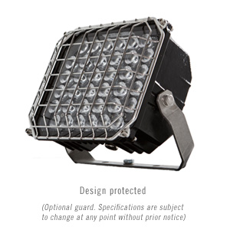
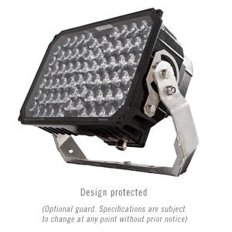
LED FLOODLIGHT RLX C-D-E
LED headlights with integrated ballast.
Comes in 3 sizes for lighting needs . RLX C replaces one 500W halogen floodlight throws.
RLX D can replace a 400W HPS floodlight throws, and RLX E throughout 240W LED can replace a 2X400W spotlight.
Designed and tested to withstand the most part. RLX series come in many varieties beam of 10 * -120 *
https://www.youtube.com/watch?v=DXnmUqcc1S4

Slide 30
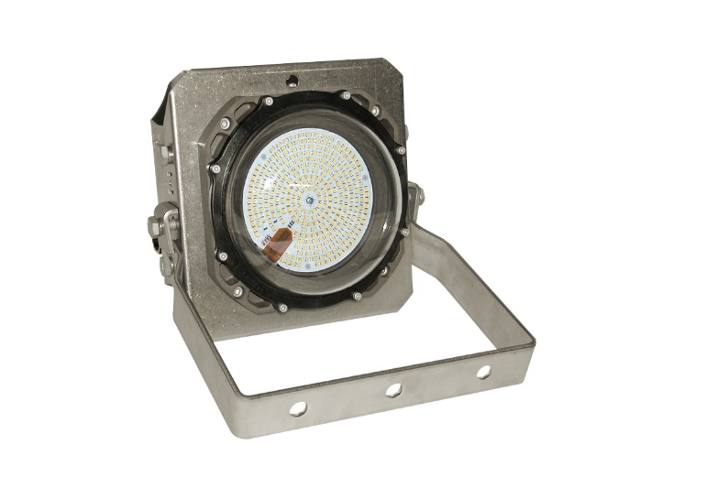
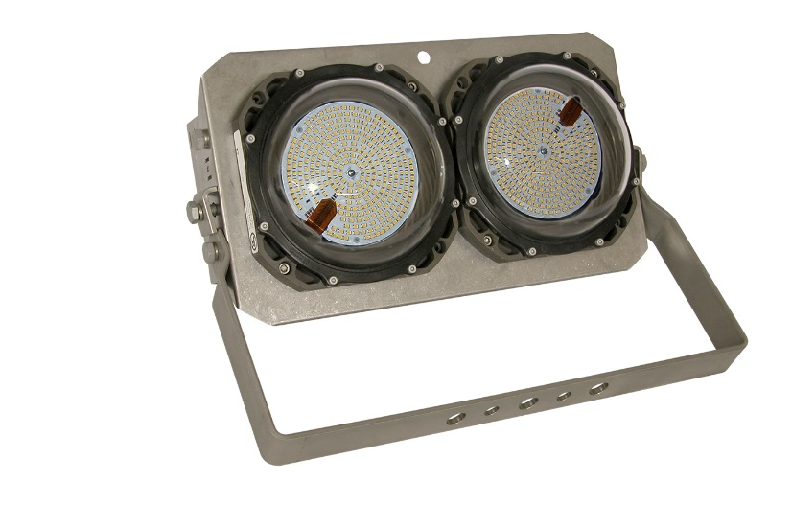
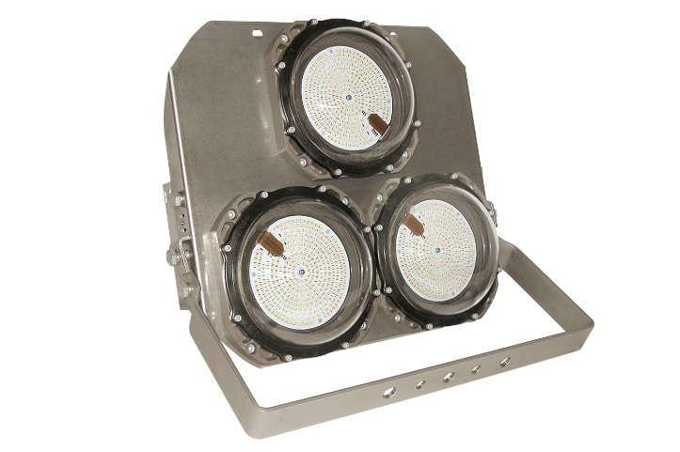
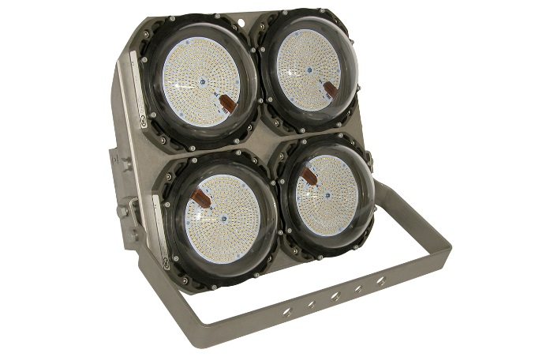
GLAMOX LED FLOODLIGHT FL60
LED headlights with integrated ballast Comes with 1.4 modules.
FL60 is made safe area, but can also be delivered as ATEX variant type FX60.
Bearing in seawater resistant aluminum and stainless bracket IP66 / 67.

Slide 31




GLAMOX BRANDS

Slide 32





DNH (Den Norske Høyttalerfabrikk)‏

Slide 33


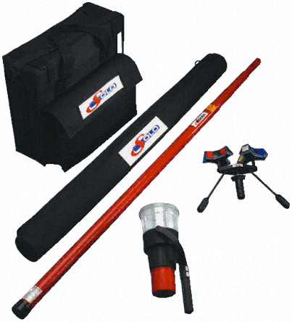
FIRE & SECURITY

Slide 34
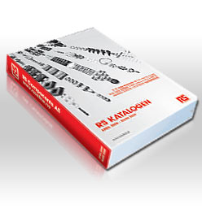

RS COMPONENTS
Welcome to RS COMPONENTS RS is Europe's leading distributor of electronic, electrical and industrial components. We've got the best products and stock availability in the business, with fast, easy ordering, next day delivery, and free technical help. We offer same day dispatch of over 160,000 products, plus online access to an extended range of another 100,000. So you can be sure we'll have what you need.

Slide 35

ELFA DISTRELEC
Elfa Distrelec is one of the leading catalogue distributors in northern Europe. We market and distribute more than 100 000 electronics components from about 650 suppliers from all over the world. Elfa Distrelec is represented through subsidiaries in Norway, Denmark, Finland, Poland, Estonia, Latvia, Lithuania and the Ukraine and we also have shops in most of these countries. We are also represented by resellers in Russia and about ten other eastern European countries. ELFA has approximately 351 employees and a turnover of 96,6 million Euros. The ELFA-catalogue, the reference book of the electronics business, is distributed in 120.000 copies, to electronics user in all markets where we operate.

Slide 36


Schneider Electric
Brands:
Schneider Electric
Merlin Gerin
Telemecanique
Sarel
Thorsman
Wibe
Merten
Norwesco
Himel

Slide 37




ABB

Slide 38



HEPAC partners – visible and technical suppliers

Slide 39
OUR CUSTOMERS
Main agreements
Incentra A/L
40 Norwegian shipowners all over the country
Fraktefartøyenes rederiforening
98 Norwegian shipowners all over the country
We also have contracts with several other shipowners in Norway and abroad, as well as industrial companies.

Slide 40

ADRESS AND WAREHOUSE:
SH Trading AS
Leirvikflaten 7
5179 Godvik
Norway
Tlf: +47 55 94 29 29
Mail: salg@sh-trading.no

